Slide 1


Kenneth Fields
10/25/2022

Slide 2

Outline
Executive Summary
Introduction
Methodology
Results
Conclusion
Appendix

Slide 3
Introduction
SpaceX advertises Falcon 9 rocket launches on its website with a cost of 62 million dollars; other providers cost upwards of 165 million dollars each, much of the savings is because SpaceX can reuse the first stage. Therefore, if we can determine if the first stage will land, we can determine the cost of a launch.
We want to determine if we can predict a successful landing and use that to predict the overall cost of the rocket launch.

Slide 4

Section 1

Slide 5
Methodology
Executive Summary
Data collection methodology:
Data was scraped from SpaceX REST API - https://api.spacexdata.com/v4/
Perform data wrangling
Data collected from SpaceX Rest API was processed using pandas and numpy software libraries.
Perform exploratory data analysis (EDA) using visualization and SQL
Perform interactive visual analytics using Folium and Plotly Dash
Perform predictive analysis using classification models
Preprocessed data was split into training and testing splits. Classification models were built using sklearn module GridSearchCV

Slide 6
Data Collection
Data was scraped from SpaceX REST API - https://api.spacexdata.com/v4/
You need to present your data collection process use key phrases and flowcharts

Slide 7
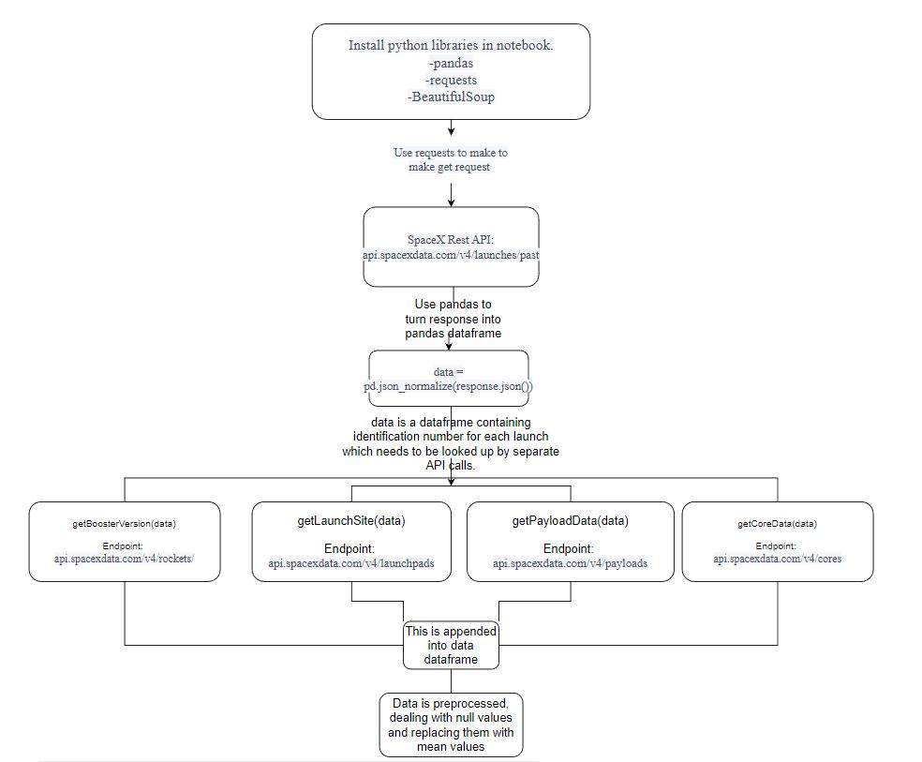
Data Collection – SpaceX API
Data was scraped from SpaceX REST API - https://api.spacexdata.com/v4/
Github:
https://github.com/kfields110/IBM_Capstone
Place your flowchart of SpaceX API calls here

Slide 8
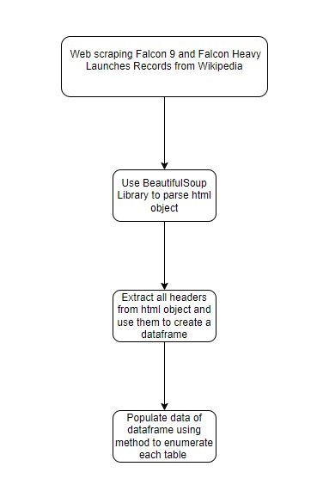
Data Collection - Scraping
Web scraping performed on WikiPedia using BeautifulSoup library
Github:
https://github.com/kfields110/IBM_Capstone
Place your flowchart of web scraping here

Slide 9
Data Wrangling
Data is processed using the pandas Python library
We would like landing outcomes in the dataframe to be converted to either 0 (booster did not land) or 1(booster did land)
We add a column to dataframe called landing_class containing 0 or 1 for landing result
Github:
https://github.com/kfields110/IBM_Capstone

Slide 10
EDA with Data Visualization
EDA was performed using Python, Pandas, SQL and Jupyter Notebook
Scatter plots were used to compare payload masses to launch sites, flight number vs orbit type, payload vs orbit type.
Line Chart to show trend in success rate over time.
Github: https://github.com/kfields110/IBM_Capstone

Slide 11
EDA with SQL
Data was explored with SQL to find:
Different Launch Sites
Avg payload mass
Successful launches
Total # of Success vs Failed mission outcomes
Types of Boosters for different payloads.
Github: https://github.com/kfields110/IBM_Capstone

Slide 12
Build an Interactive Map with Folium
Interactive map built with Folium library to show launch sites of rockets
Folium.Circle to indicate an area for the launch site
Folium.Marker to create an icon to label the area
Marker Clusters were used to highlight successful (green) and failed(red) launches
Lines were added to show the distance of each launch site from the nearest coast and city to see if there were patterns in launch location.
Summarize what map objects such as markers, circles, lines, etc. you created and added to a folium map
These objects were added to quickly visualize patterns for launch locations.
Github: https://github.com/kfields110/IBM_Capstone

Slide 13
Build a Dashboard with Plotly Dash
Plotly Dashboard allows for quick visualization of successful launches of each of the 4 launch sites.
The dashboard contains pie graphs of the ratio of successful launches between each launch site and a slider to quickly see which size payloads have successful launches.
Github: https://github.com/kfields110/IBM_Capstone

Slide 14
Predictive Analysis (Classification)
Machine Learning Models were built using python, pandas, and sklearn libraries.
Data was preprocessed and made Success/Failed launch the dependant variable to model.
4 Models were produced:
Regression
SVM
Decision Tree
K nearest neighbor
Decision Tree Classifier had the highest accuracy.

Slide 15

Section 2

Slide 16
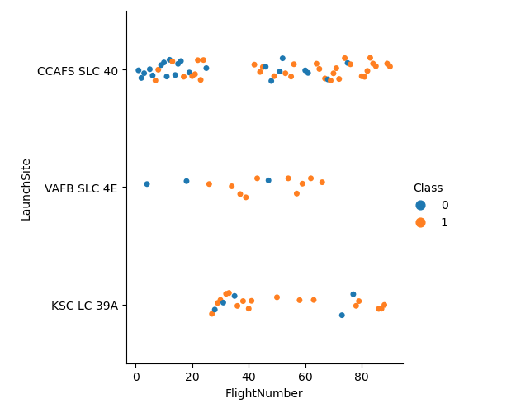
Flight Number vs. Launch Site
Class 0 - Failure
Class 1 - Success
Most launches were at CCAFS SLC 40.
Higher success rates, however, were at VAFB SLC 4E and KSC LC 39A launch sites.

Slide 17
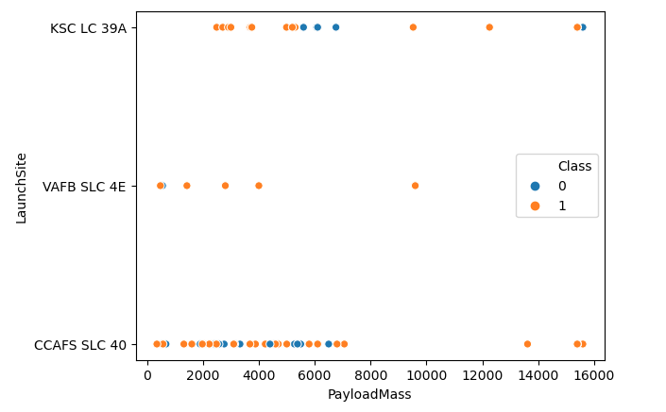
Payload vs. Launch Site
As the payload mass increased, the rate of success also increased. Only 1 failure with a payload mass > 8000 kg.

Slide 18
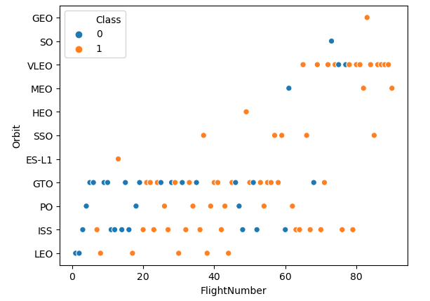
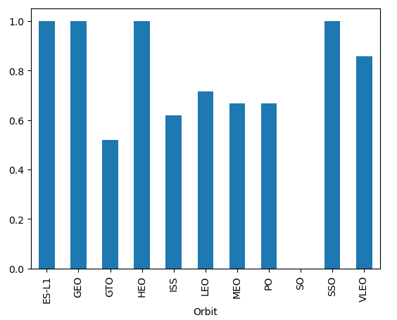
Success Rate vs. Orbit Type
We see that for most orbit types, as the number of flights increased, the success rate increased as well. Most failures occurred before flight number 40.

Slide 19
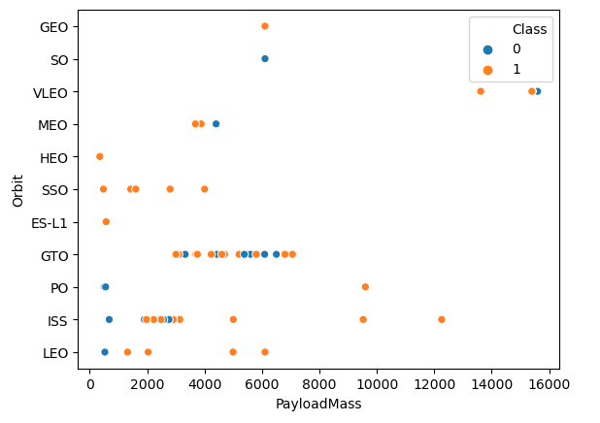
Payload vs. Orbit Type
Increasing the payload seems to increase success rates with LEO, ISS, and PO orbits.
GTO seemed to have no correlation.

Slide 20
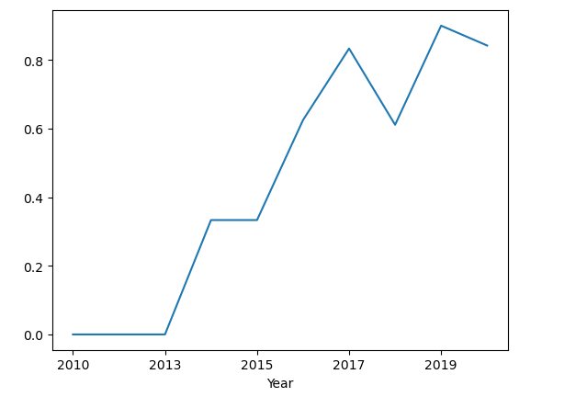
Launch Success Yearly Trend
Success rate has steadily increased year over year with a small dip in 2018.

Slide 21
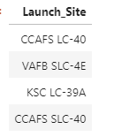
All Launch Site Names
4 unique launch sites.
SQL query: %%sql select distinct Launch_Site from SPACEXTBL
SPACEXTBL is a sql database that was converted from a pandas dataframe, enabling SQL queries in a jupyter notebook.

Slide 22
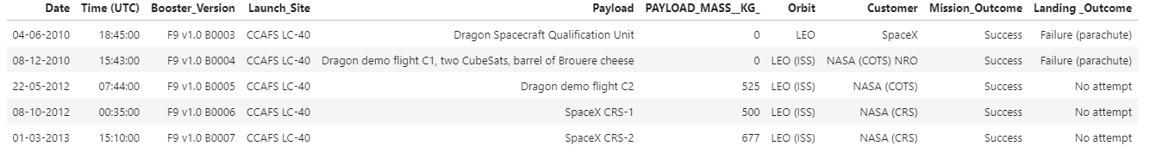
Launch Site Names Begin with 'CCA'
SQL Query:
%%sql select * from SPACEXTBL
where Launch_Site LIKE '%CCA%'
LIMIT 5

Slide 23
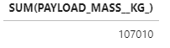
Total Payload Mass
Calculate the total payload carried by boosters from NASA
SQL Query:
%%sql
SELECT SUM(PAYLOAD_MASS__KG_)
FROM SPACEXTBL
WHERE CUSTOMER LIKE '%NASA%'

Slide 24
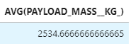
Average Payload Mass by F9 v1.1
Calculate the average payload mass carried by booster version F9 v1.1
SQL Query
%%sql
SELECT AVG(PAYLOAD_MASS__KG_)
FROM SPACEXTBL
WHERE Booster_Version LIKE 'F9 v1.1%'

Slide 25
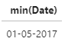
First Successful Ground Landing Date
Find the dates of the first successful landing outcome on ground pad
SQL Query:
%%sql
SELECT min(Date)
FROM SPACEXTBL
WHERE "Landing _Outcome" = 'Success (ground pad)'

Slide 26
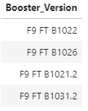
Successful Drone Ship Landing with Payload between 4000 and 6000
List the names of boosters which have successfully landed on drone ship and had payload mass greater than 4000 but less than 6000
SQL Query:
%%sql
SELECT Booster_Version
FROM SPACEXTBL
WHERE "Landing _Outcome" = 'Success (drone ship)' and PAYLOAD_MASS__KG_ > 4000 and PAYLOAD_MASS__KG_ < 6000

Slide 27
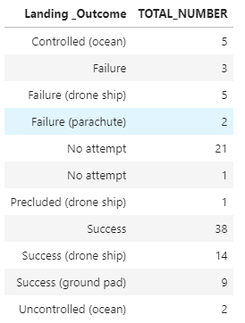
Total Number of Successful and Failure Mission Outcomes
Calculate the total number of successful and failure mission outcomes
SQL Query:
%%sql
SELECT "Landing _Outcome", COUNT("Landing _Outcome") AS TOTAL_NUMBER
FROM SPACEXTBL
GROUP BY "Landing _Outcome";

Slide 28
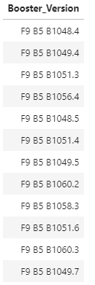
Boosters Carried Maximum Payload
List the names of the booster which have carried the maximum payload mass
SQL Query:
%%sql
SELECT DISTINCT BOOSTER_VERSION
FROM SPACEXTBL
WHERE PAYLOAD_MASS__KG_ = (
SELECT MAX(PAYLOAD_MASS__KG_)
FROM SPACEXTBL);

Slide 29
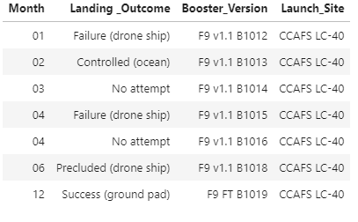
2015 Launch Records
List the failed landing_outcomes in drone ship, their booster versions, and launch site names for in year 2015
SQL Query:
%%sql
SELECT substr(Date, 4, 2) as Month,"Landing _Outcome",BOOSTER_VERSION,LAUNCH_SITE
FROM SPACEXTBL
WHERE substr(Date,7,4)='2015';

Slide 30
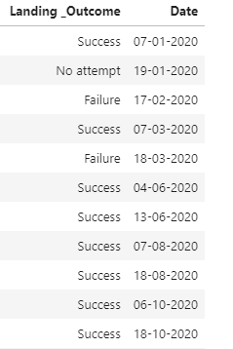
Rank Landing Outcomes Between 2010-06-04 and 2017-03-20
Rank the count of landing outcomes (such as Failure (drone ship) or Success (ground pad)) between the date 2010-06-04 and 2017-03-20, in descending order
SQL Query:
%%sql
SELECT "Landing _Outcome", Date
FROM SPACEXTBL
WHERE DATE BETWEEN '04-06-2010' AND '20-03-2017'
ORDER BY substr(Date,7,4) DESC;
Result to large to show all

Slide 31

Section 3

Slide 32
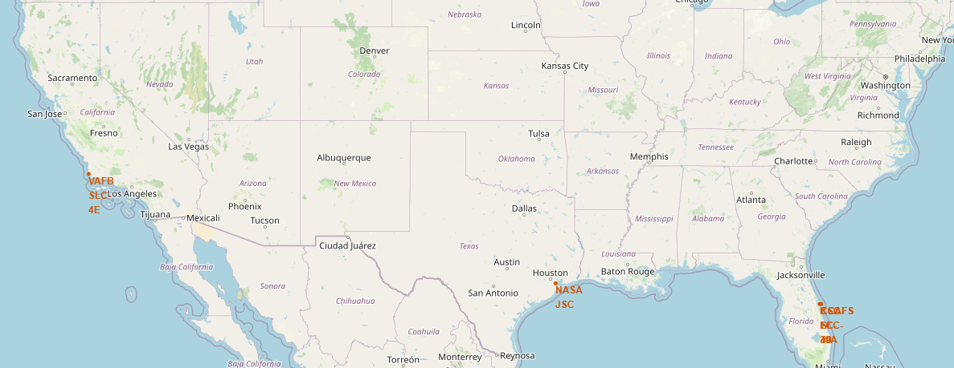
Launch Site Analysis with Folium
The above map was generated with Folium. 4 launch locations are included - VAFB, NASA JSC, CCAFS, and JKSC
The launch sites are located nearest the equator.
Each launch site is very close to the coast, with access to highways.
Each launch site is located outside of major metropolitan areas.

Slide 33
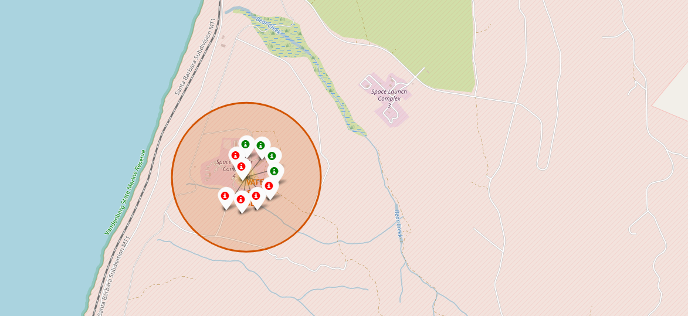
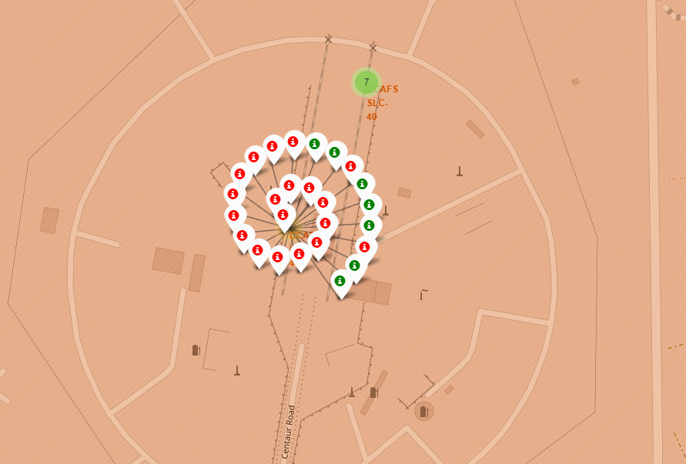
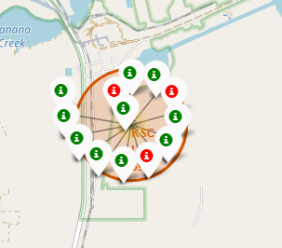
Launch Outcomes
Maps on the side show outcomes of launch
Green - Successful Launch
Red - Failed Launch
John Kennedy Space Center has the highest percentage of successful launches.
VAFB
CCAFS
JKS

Slide 34
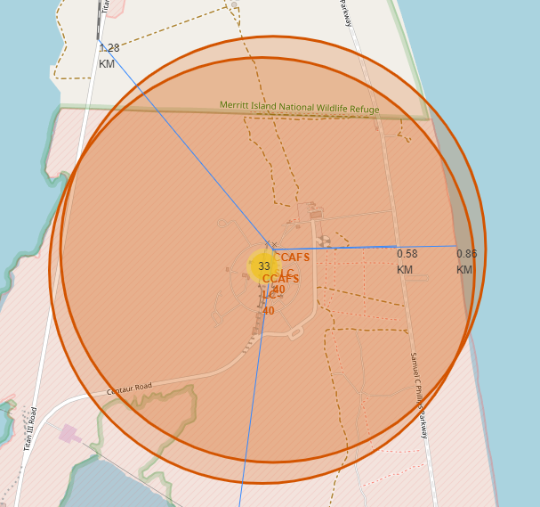
Distance from Landmarks
Each Space station is labeled with a blue line to indicate distance from nearest railway, coastline, highway, and city center.
Patterns emerged from this with each launch site being in close proximity to each, while being far from city center.

Slide 35

Section 4

Slide 36
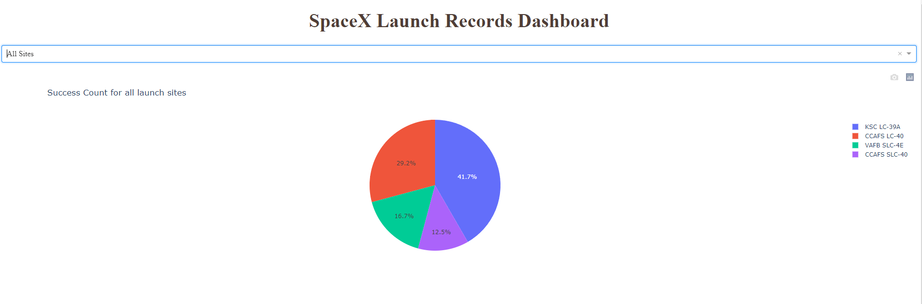
SpaceX Dashboard with Plotly
Screenshot shows which site accounts for most of the successful launches. Kennedy Space Center has the most with 41.7% of all successful launches.

Slide 37
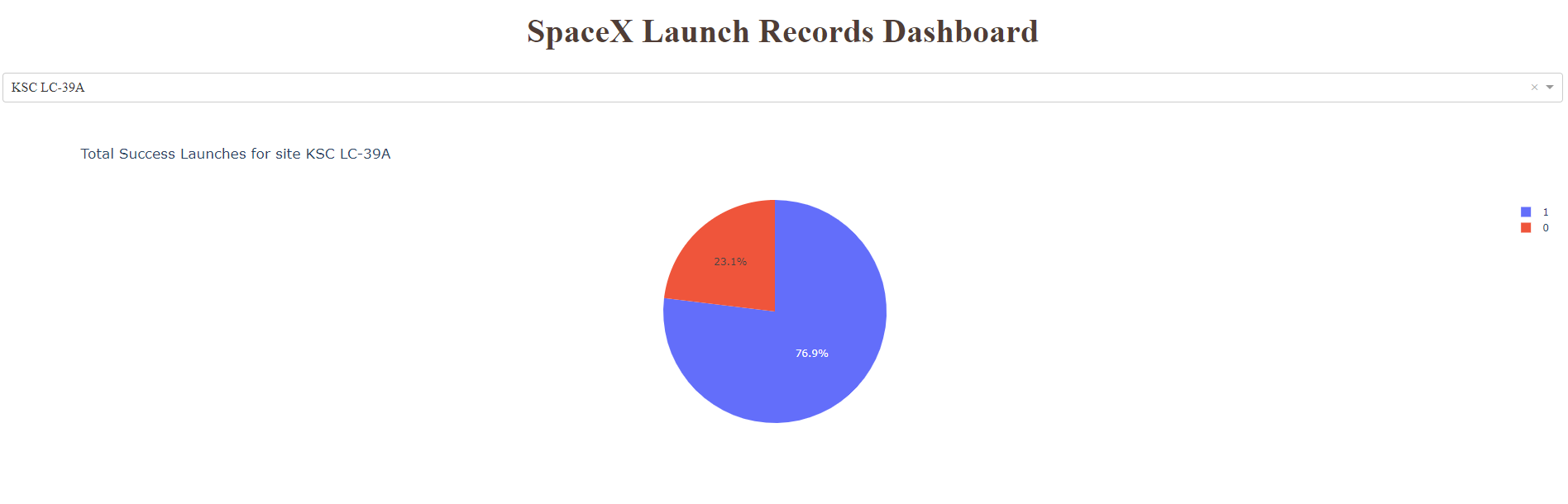
Kennedy Space Center Success
Kennedy Space Center has a 76% success rate with all launches.

Slide 38
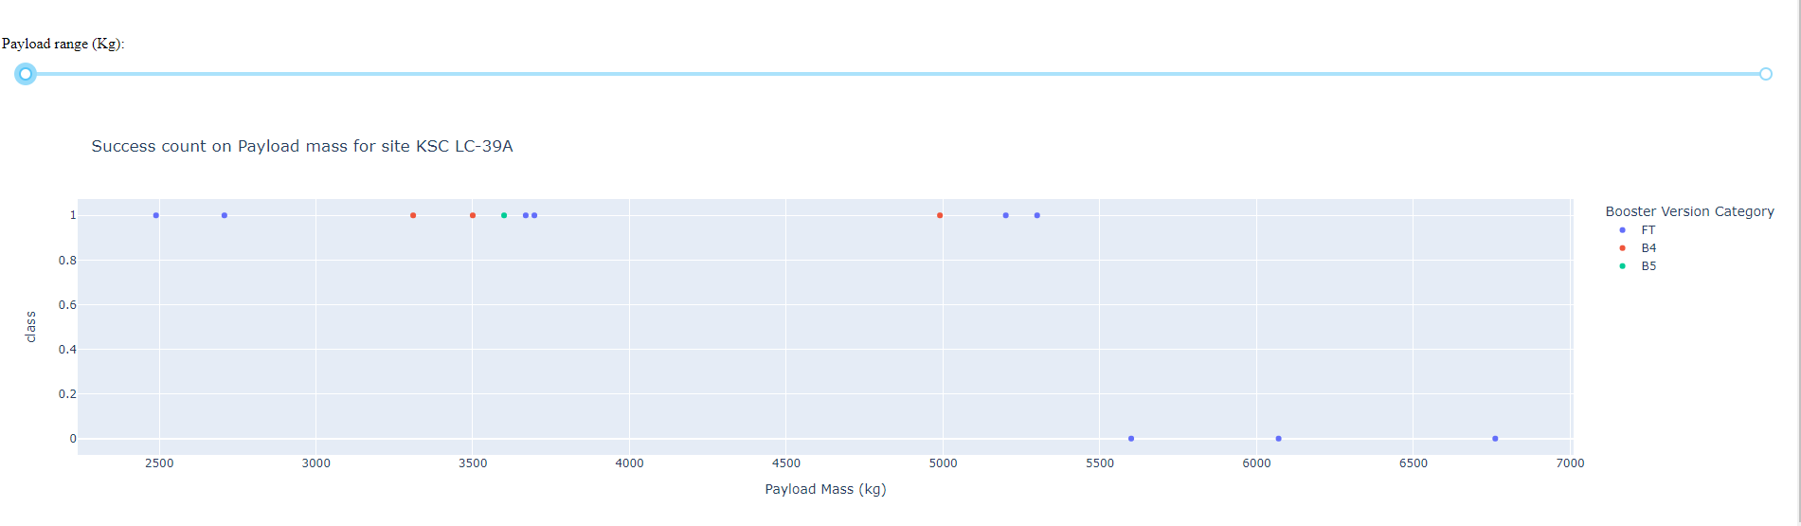
Payload vs. Launch Outcome
Launch Success shows some correlation with Payload Mass. Once Payload mass reached 5500kg, there were 3 successive failures.

Slide 39

Section 5

Slide 40
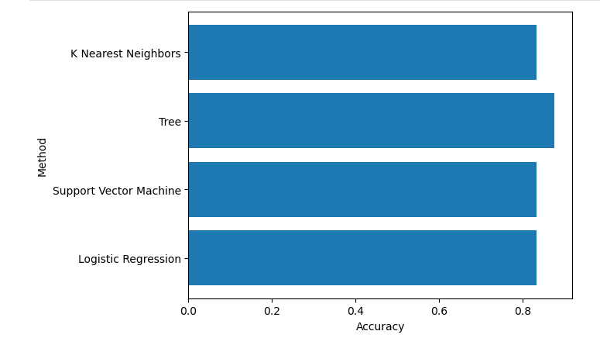
Classification Accuracy
Decision Tree Model has the highest accuracy of 87.5%

Slide 41
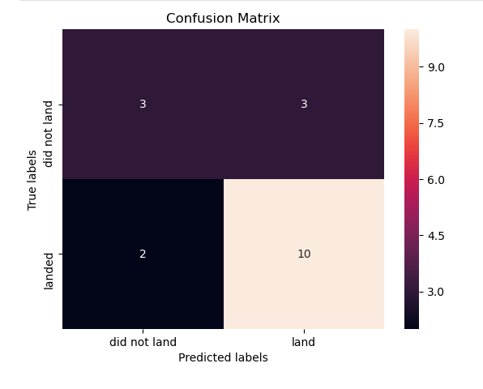
Confusion Matrix
Decision Tree Model correctly predicted 10/12 successful landings, and 3/6 failed landings.
The model has significantly higher accuracy predicted successful landings which should give confidence when launching.

Slide 42
Conclusions
SpaceX has increased the success rate of launches every year since 2015.
Trends show that as SpaceX was more successful, payload Mass increased per launch with a sustained success rate.
Launch Sites all follow similar patterns
Close proximity to coastlines, railways, highways
Far from city centers
Machine Learning Models can predict successful launches at nearly 90%

Slide 43
Appendix
Github Repository for all code, notebooks: https://github.com/kfields110/IBM_Capstone

Slide 44


